Slide 1
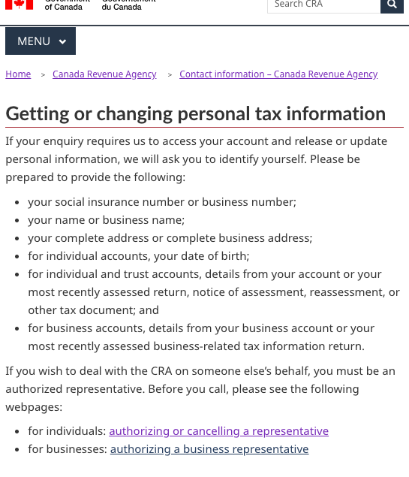
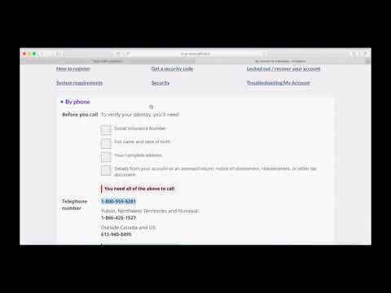
Interaction engages people to prepare & could reduce call wait times
People notice and click the boxes, understand it's items to get
People don’t click the link for this page so weren’t prepared for calls
P7T2: “You need all the above to call”
Watch people use the checklist: https://youtu.be/6oXpOrSpl1o

